Slide 1

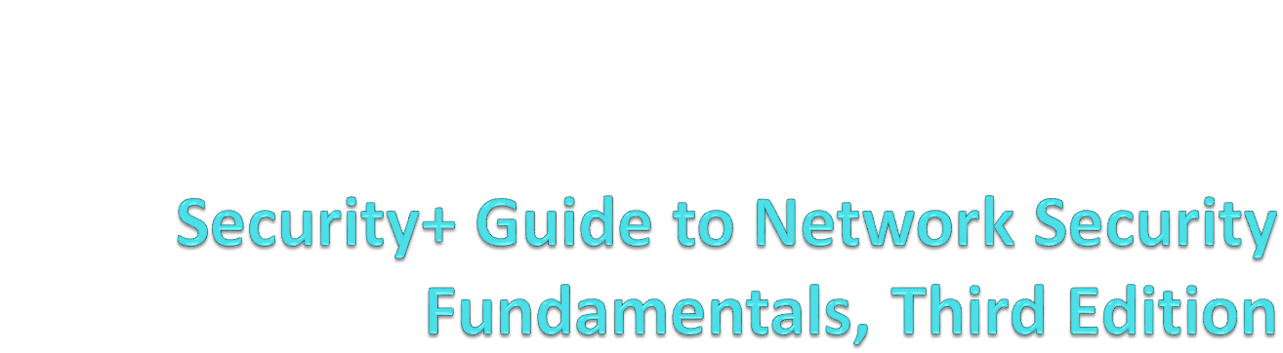
Section 2
Network Vulnerabilities and Attacks

Slide 2
Cyberwar and Cyberterrorism
"Titan Rain" - Attacks on US gov't and military computers from China breached hundreds of systems in 2005 (link Ch 4a)
In 2007, Estonia was attacked by Russian computers as a political statement
  Using DDoS (Distributed Denial of Service) with botnets (Ch 4b)

Slide 3
Objectives
Explain the types of network vulnerabilities
List categories of network attacks
Define different methods of network attacks

Slide 4


Slide 5
Media-Based Vulnerabilities
Monitoring network traffic
  Helps to identify and troubleshoot network problems
Monitoring traffic can be done in two ways
  Use a switch with port mirroring
    Copies all traffic to a designated monitoring port on the switch
  Install a network tap (test access point)
    A device that installed between two network devices, such as a switch, router, or firewall, to monitor traffic

Slide 6
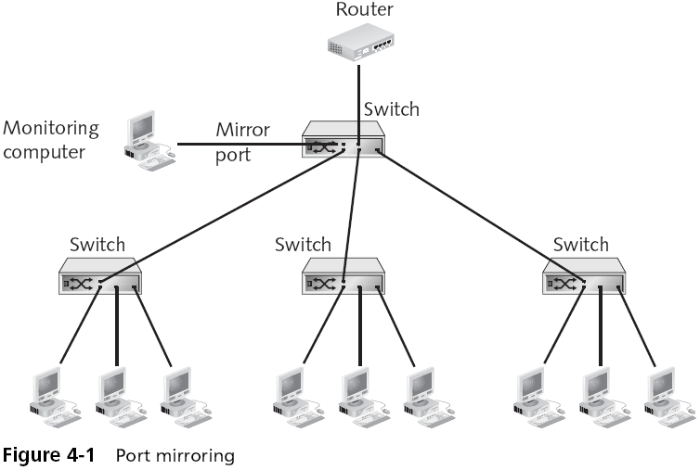
Port Mirroring

Slide 7
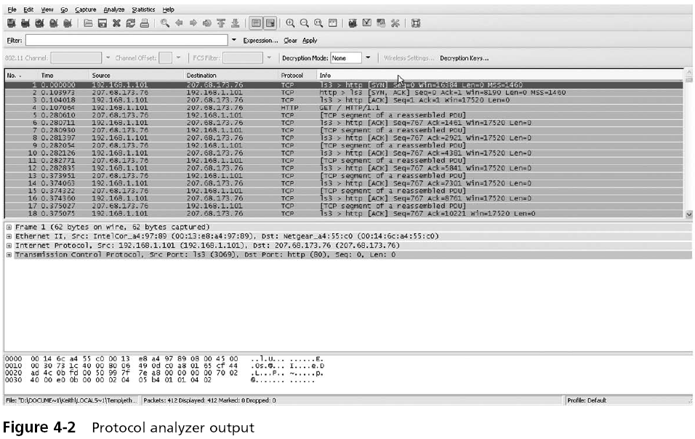
Sniffer

Slide 8
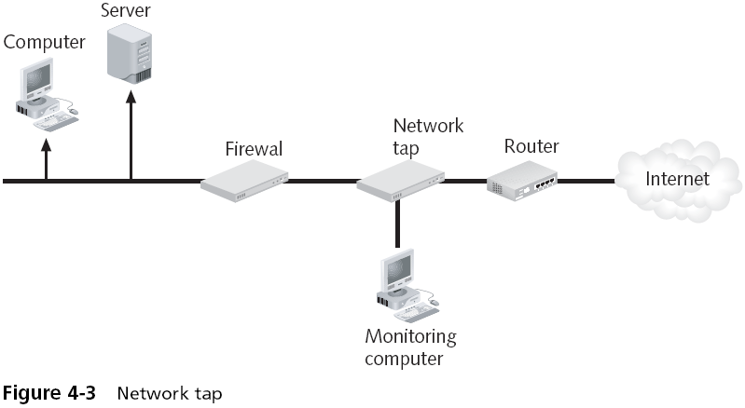
Network Tap

Slide 9
Sniffing Attacks
Just as network taps and protocol analyzers can be used for legitimate purposes
  They also can be used by attackers to intercept and view network traffic
Attackers can access the wired network in the following ways:
  False ceilings
  Exposed wiring
  Unprotected RJ-45 jacks

Slide 10
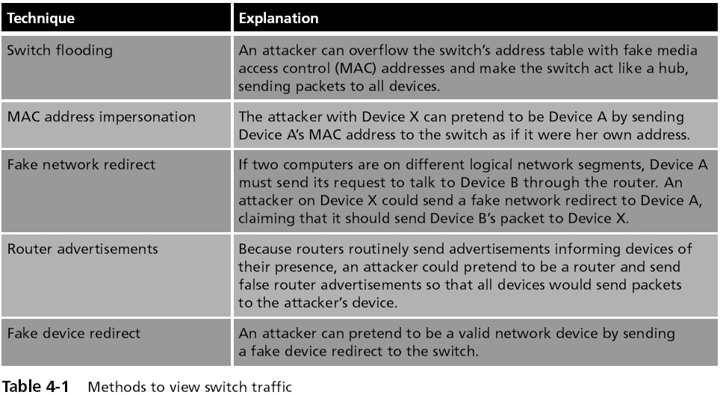
Ways to Redirect Switched Traffic

Slide 11
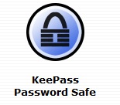
Network Device Vulnerabilities
Passwords
  Passwords should be long and complex
  Should be changed frequently
  Should not be written down
But that is a difficult task
Solution: Password Manager Software (link Ch 4d)

Slide 12
Characteristics of Weak Passwords
A common word used as a password
Not changing passwords unless forced to do so
Passwords that are short
Personal information in a password
Using the same password for all accounts
Writing the password down

Slide 13
Network Device Vulnerabilities
Default account
  A user account on a device that is created automatically by the device instead of by an administrator
  Used to make the initial setup and installation of the device (often by outside personnel) easier
Although default accounts are intended to be deleted after the installation is completed, often they are not
Default accounts are often the first targets that attackers seek

Slide 14
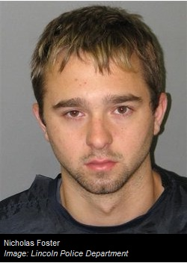
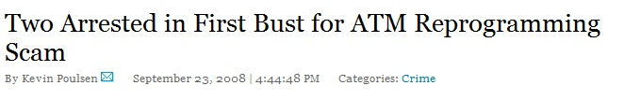
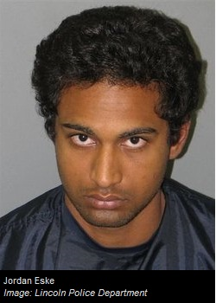
ATM Passwords
In 2008, these men used default passwords to reprogram ATM machines to hand out $20 bills like they were $1 bills
  Link Ch 4e

Slide 15
Network Device Vulnerabilities
Back door
  An account that is secretly set up without the administrator’s knowledge or permission, that cannot be easily detected, and that allows for remote access to the device
Back doors can be created:
  By a virus, worm, or Trojan horse
  By a programmer of the software on the device
  Built into the hardware chips

Slide 16
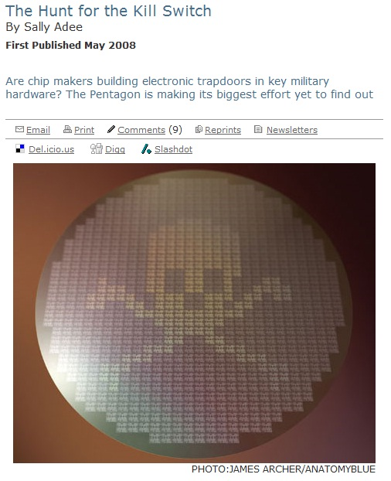
Hardware Trojans
Military equipment contains chips from foreign countries
Those chips can contain backdoors or kill switches
  Link Ch 4e

Slide 17
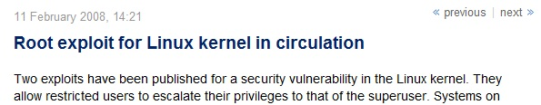
Network Device Vulnerabilities
Privilege escalation
  Changing a limited user to an Administrator
    Link Ch 4g

Slide 18


Slide 19
Denial of Service (DoS)
Attempts to consume network resources so that the network or its devices cannot respond to legitimate requests
Example: SYN flood attack
  See Figure 4-4
Distributed denial of service (DDoS) attack
  A variant of the DoS
  May use hundreds or thousands of zombie computers in a botnet to flood a device with requests

Slide 20
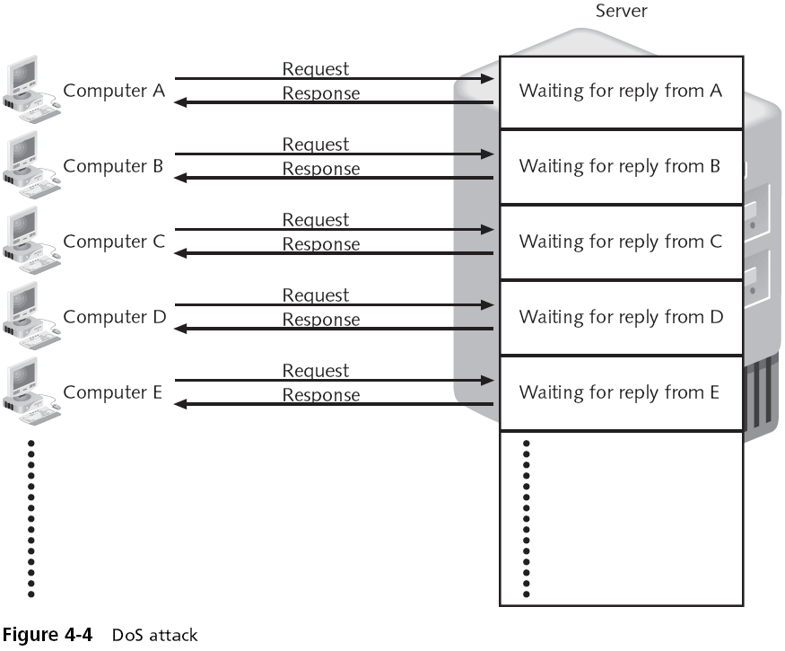

Slide 21
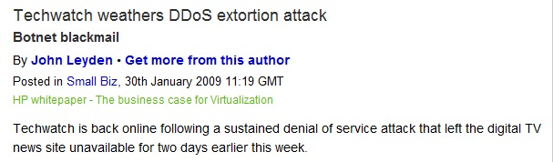
Real DDoS Attack
Link Ch 4i

Slide 22
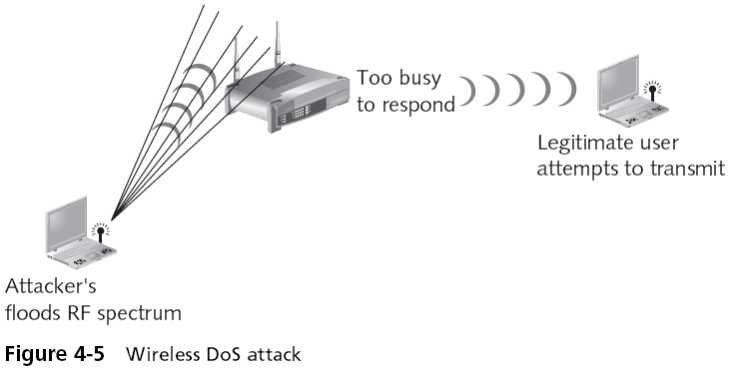
Wireless DoS
Requires a powerful transmitter

Slide 23
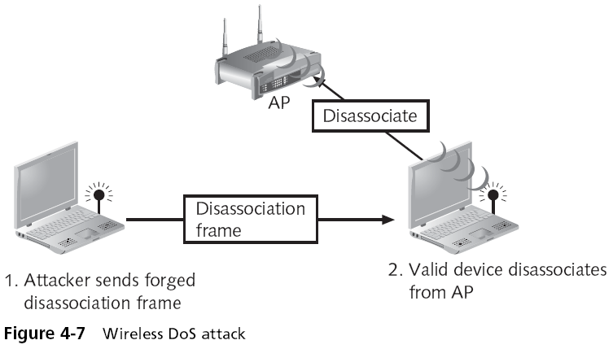
An Easier Wireless DoS

Slide 24
Spoofing
Spoofing is impersonation
  Attacker pretends to be someone else
Malicious actions would be attributed to another user
Spoof the network address of a known and trusted host
Spoof a wireless router to intercept traffic

Slide 25
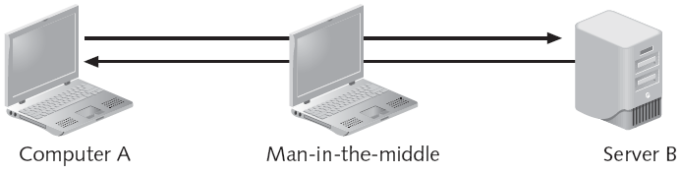
Man-in-the-Middle Attack
Passive--attacker reads traffic
Active--attacker changes traffic
Common on networks

Slide 26
Replay Attack
Attacker captures data
Resends the same data later
  A simple attack: capture passwords and save them

Slide 27
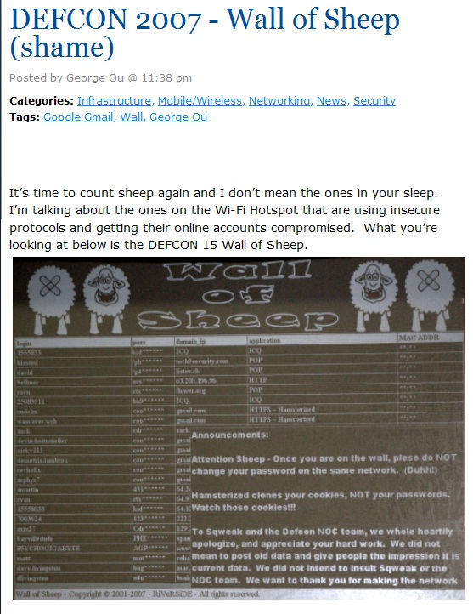
Wall of Sheep
Captured passwords projected on the wall at DEFCON
Link Ch 4j

Slide 28
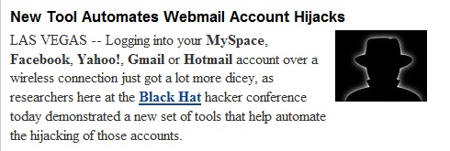
Sidejacking
Records cookies and replays them (link Ch 4k)
This technique breaks into Gmail accounts
Technical name: Cross Site Request Forgery
Almost all social networking sites are vulnerable to this attack
  Facebook, MySpace, Yahoo, etc.

Slide 29
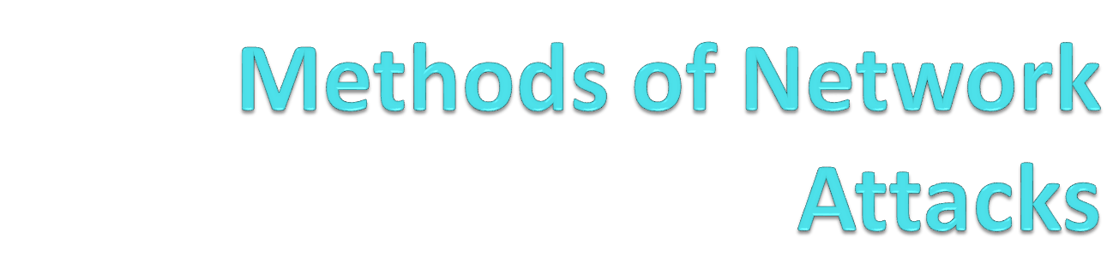

Slide 30
SNMP (Simple Network Management Protocol)
Used to manage switches, routers, and other network devices
Early versions did not encrypt passwords, and had other security flaws
But the old versions are still commonly used

Slide 31
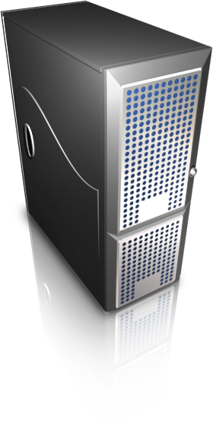
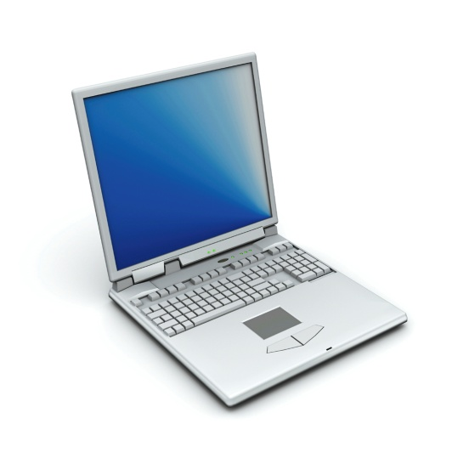
DNS (Domain Name System)
DNS is used to resolve domain names like www.ccsf.edu to IP addresses like 147.144.1.254
DNS has many vulnerabilities
  It was never designed to be secure
Where is www.ccsf.edu?
www.ccsf.edu is at 147.144.1.254

Slide 32
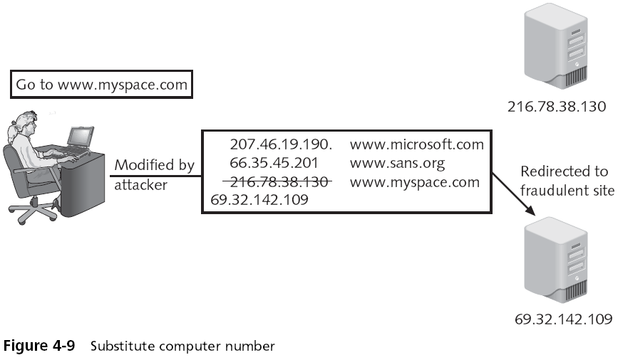
DNS Poisoning

Slide 33
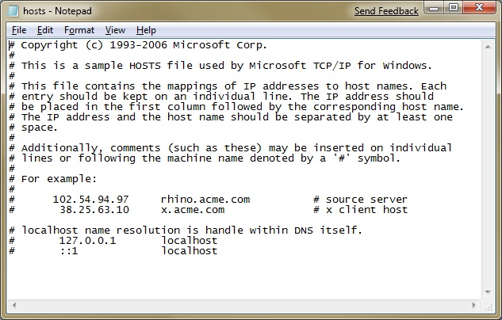
Local DNS Poisoning
Put false entries into the Hosts file
C:\Windows\System32\Drivers\etc\hosts

Slide 34

DNS Cache Poisoning
Attacker sends many spoofed DNS responses
Target just accepts the first one it gets
www.ccsf.edu is at 63.145.23.12
Where is www.ccsf.edu?
www.ccsf.edu is at 147.144.1.254

Slide 35
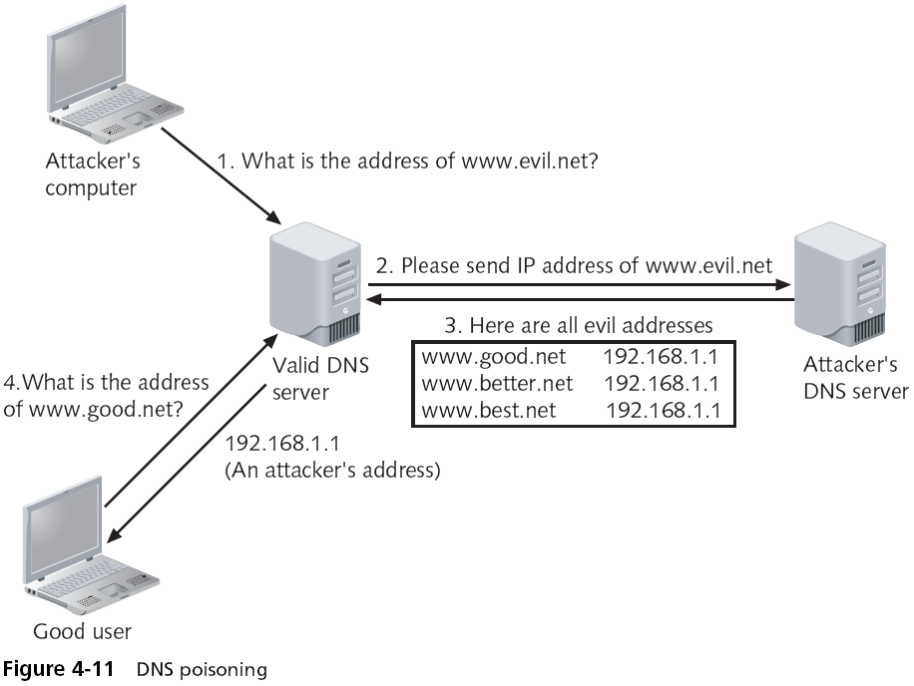
Sending Extra DNS Records

Slide 36
DNS Transfers
Intended to let a new DNS server copy the records from an existing one
Can be used by attackers to get a list of all the machines in a company, like a network diagram
  Usually blocked by modern DNS servers

Slide 37
Protection from DNS Attacks
Antispyware software will warn you when the hosts file is modified
Using updated versions of DNS server software prevents older DNS attacks against the server
But many DNS flaws cannot be patched
Eventually: Switch to DNSSEC (Domain Name System Security Extensions)
  But DNSSEC is not widely deployed yet, and it has its own problems
  Link Ch 4l

Slide 38
ARP (Address Resolution Protocol)
ARP is used to convert IP addresses like 147.144.1.254 into MAC addresses like 00-30-48-82-11-34
Where is 147.144.1.254?
147.144.1.254 is at 00-30-48-82-11-34

Slide 39
ARP Cache Poisoning
Attacker sends many spoofed ARP responses
Target just accepts the first one it gets
147.144.1.254 is at 00-00-00-4A-AB-07
Where is 147.144.1.254?
147.144.1.254 is at 00-30-48-82-11-34

Slide 40
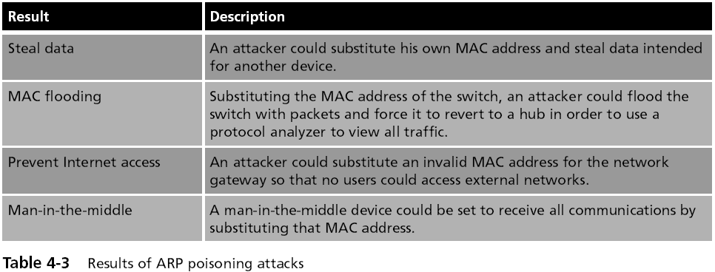
Results of ARP Poisoning Attacks

Slide 41
TCP/IP Hijacking
  Takes advantage of a weakness in the TCP/IP protocol
  The TCP header contains of two 32-bit fields that are used as packet counters
    Sequence and Acknowledgement numbers
  Packets may arrive out of order
    Receiver uses the Sequence numbers to put the packets back in order

Slide 42
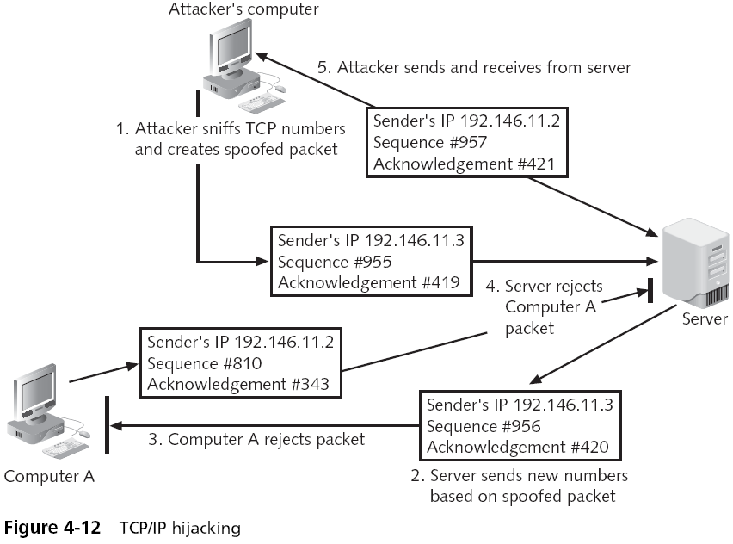

Slide 43
Wireless Attacks
Rogue access points
  Employees often set up home wireless routers for convenience at work
  This allows attackers to bypass all of the network security and opens the entire network and all users to direct attacks
  An attacker who can access the network through a rogue access point is behind the company's firewall
    Can directly attack all devices on the network

Slide 44
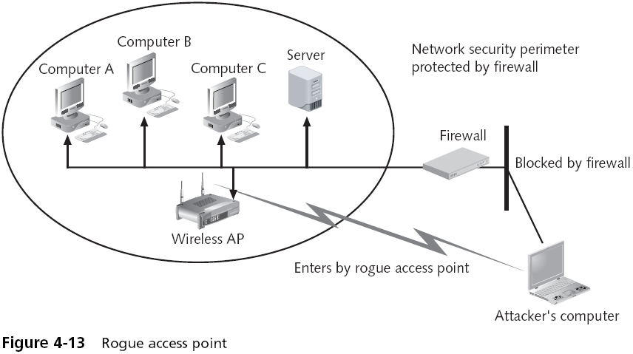

Slide 45
Wireless Attacks (continued)
War driving
  Beaconing
    At regular intervals, a wireless AP sends a beacon frame to announce its presence and to provide the necessary information for devices that want to join the network
  Scanning
    Each wireless device looks for those beacon frames
  Unapproved wireless devices can likewise pick up the beaconing RF transmission
  Formally known as wireless location mapping

Slide 46
Wireless Attacks (continued)
War driving (continued)
  War driving technically involves using an automobile to search for wireless signals over a large area
  Tools for conducting war driving:
    Mobile computing device
    Wireless NIC adapters
    Antennas
    Global positioning system receiver
    Software

Slide 47
Wireless Attacks (continued)
Bluetooth
  A wireless technology that uses short-range RF transmissions
  Provides for rapid “on the fly” and ad hoc connections between devices
Bluesnarfing
  Stealing data through a Bluetooth connection
  E-mails, calendars, contact lists, and cell phone pictures and videos, …

Slide 48


Slide 49
Null Sessions
Connections to a Microsoft Windows 2000 or Windows NT computer with a blank username and password
Attacker can collect a lot of data from a vulnerable system
Cannot be fixed by patches to the operating systems
Much less of a problem with modern Windows versions, Win XP SP2, Vista, or Windows 7

Slide 50
Domain Name Kiting
Check kiting
  A type of fraud that involves the unlawful use of checking accounts to gain additional time before the fraud is detected
Domain Name Kiting
  Registrars are organizations that are approved by ICANN to sell and register Internet domain names
  A five-day Add Grade Period (AGP) permits registrars to delete any newly registered Internet domain names and receive a full refund of the registration fee

Slide 51
Domain Name Kiting
Unscrupulous registrars register thousands of Internet domain names and then delete them
Recently expired domain names are indexed by search engines
Visitors are directed to a re-registered site
  Which is usually a single page Web with paid advertisement links
Visitors who click on these links generate money for the registrar

